Slide 1
OFF-GRID CAMPUS COMMS
Off-Grid
A pure-React messenger bridged over ESP32 / ESP-NOW mesh radio
PROJECT TEAM
SK
DK
A
SN
S.V. Karan
Dev Kohli
Ashu
Sathvik Novel
RA2511056010034
RA2511056010045
RA2511056010049
RA2511056010055

Slide 2
PROJECT STATEMENT
Why this project exists
The Problem
1
Zero Infrastructure
No Wi-Fi APs, cell towers, or internet — pure device-to-device radio link.
Campus messaging today depends entirely on Wi-Fi, cellular towers, and third-party servers. When that infrastructure is unavailable, congested, or untrusted, students and teams have no private, reliable way to communicate over short distances.
2
True E2EE
AES-256-GCM encryption and decryption happen only on the JVM host, never on the ESP32.
The Goal
Build a fully off-grid, infrastructure-free, True End-to-End Encrypted terminal chat system: a pure-Java CLI application handling all logic and cryptography, physically bridged through ESP32 nodes that relay ciphertext over ESP-NOW — no APs, no internet, no servers.
100–200m Range
3
Line-of-sight ESP-NOW link between two ESP32 peer nodes.
4
Terminal-Native
Asynchronous CLI REPL — runs anywhere a JVM does, laptop to Raspberry Pi.

Slide 3
DELIVERABLE
Output & Technical Stack
H
Hardware
L
Languages & Environments
D
Dev Tools & Build Systems
2× ESP32 Development Boards
Micro-USB / USB-C cables or portable power banks
External 3dBi antennas (optional, for extended range)
Pure React WebApp — runs on laptop, desktop, or Raspberry Pi
ESP32 Firmware (C/C++)
Maven or Gradle for dependency management
IntelliJ, Eclipse, VS Code, or CLI (javac, java, Vim)
PlatformIO or Arduino IDE
Git for version control
J
Java Libraries & Frameworks
N
Networking & Protocols
P
Project Output
Terminal UI: @xterm/xterm or @xterm/addon-fit
Database: sqlite-jdbc (embedded SQLite)
Crypto: JCA — AES/GCM/NoPadding, KeyGenerator, PKCS12 KeyStore
Serial: jSerialComm or OS-level BLE wrapper
Concurrency: ExecutorService (reader/writer/UI daemon threads)
ESP-NOW — wireless ESP32-to-ESP32 peer link
Hardware Serial (UART/USB) or OS-level BLE — Host-to-ESP32 link
100% off-grid, True E2EE terminal chat (100–200m line of sight)
chat-app.jar — single executable Shadow/Fat JAR
Video demo of terminal UI + physical hardware
Finalized repo (/jvm_terminal_app, /esp32_firmware) with build/run README

Slide 4
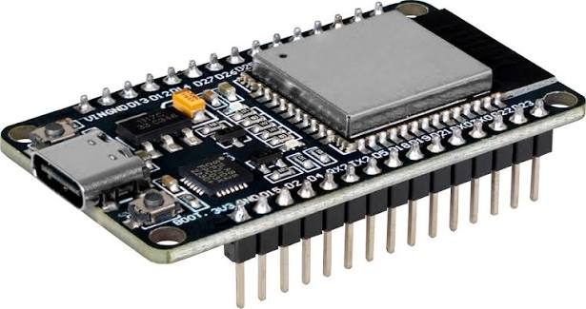
ESP32

